Slide 1



IR range sensor
Bowen lIU

Slide 2

content
introduction
application
DESIGN PROJECT

Slide 3
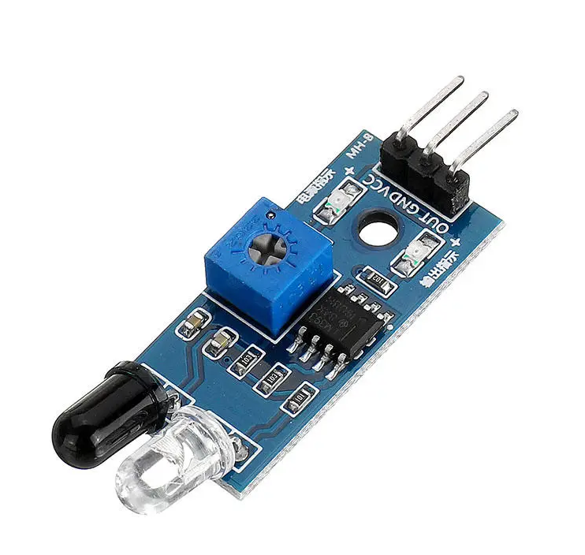
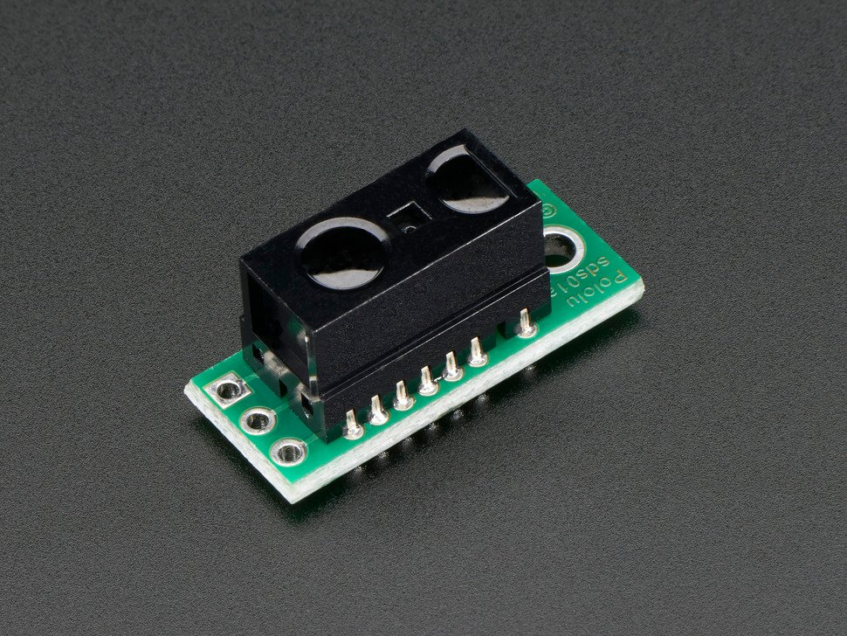
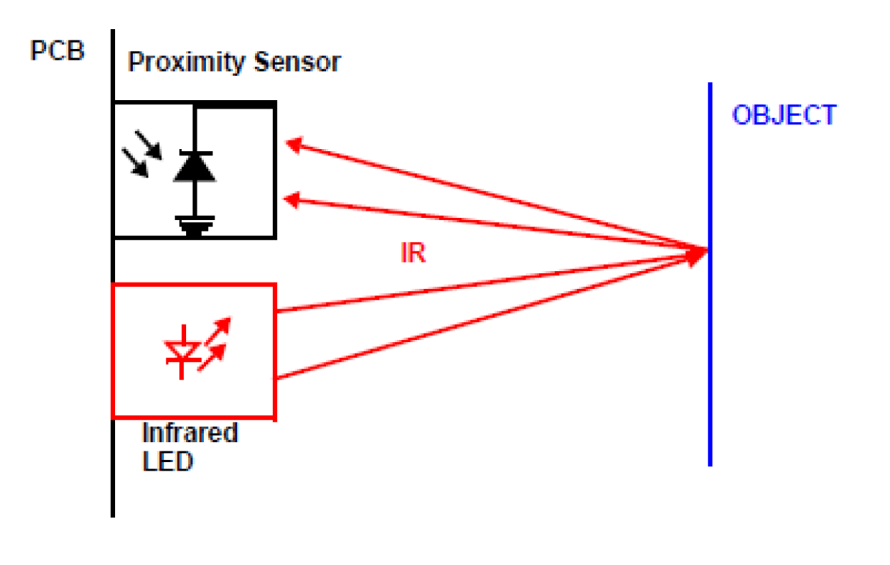
introduction

Slide 4
application
The position changing
Automobile
robot

Slide 5
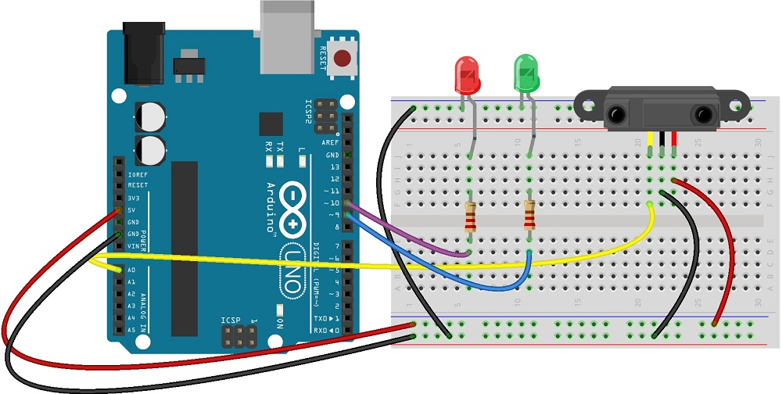
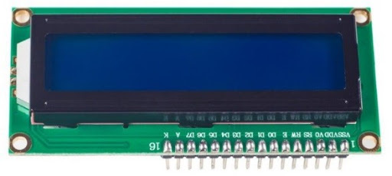
Design project

Slide 6
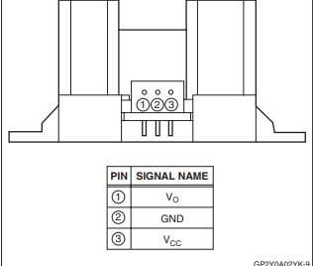
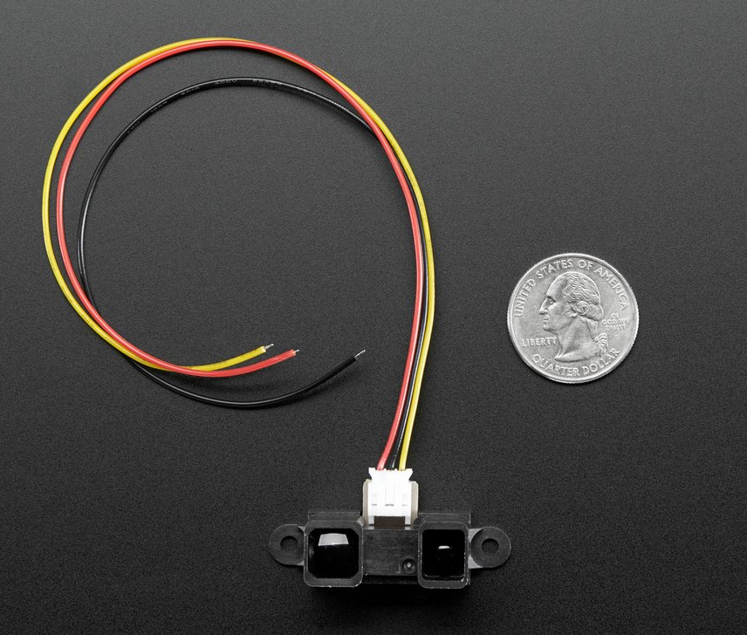
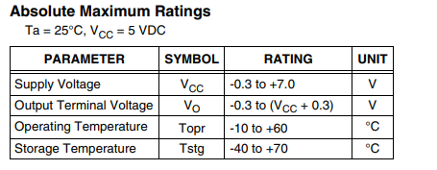
Design project
IR range sensor (Sharp GP2Y0A21YK0F)
Distance measuring range: 20 cm to 150 cm

Slide 7
Design project
Cost
Ir senior 15.95
Arduino 23
LCD(16x2) 8
WIRE AND LED 1
Resistance 2
TOTAL 49.95

Slide 8
Work cited
GP2Y0A02YK Data Sheet.pdf
https://www.adafruit.com/product/1031
https://m.eet.com/media/1051336/C0431-Figure2.gif
https://www.amazon.com/

Slide 9
Thank you

